Slide 1
Home electricity usage monitor & Motion-Driven Appliance Control
Team Members:
Dhanush s
Dhanush Kumar V
Guru prasath T

Slide 2
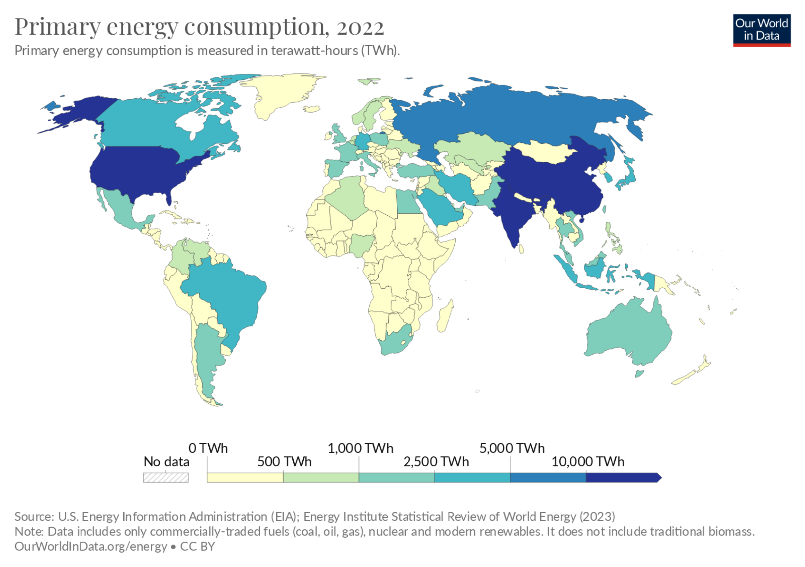
PROBLEM STATEMENT
SURVEY / STATISTICS :

Slide 3
SOLUTION ?

Slide 4

ECO AUTOMATIONS
VISION :
To enable “smart homes” which also
focus on energy consumption.

Slide 5
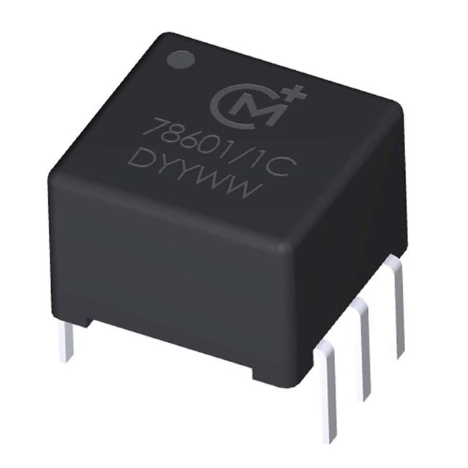
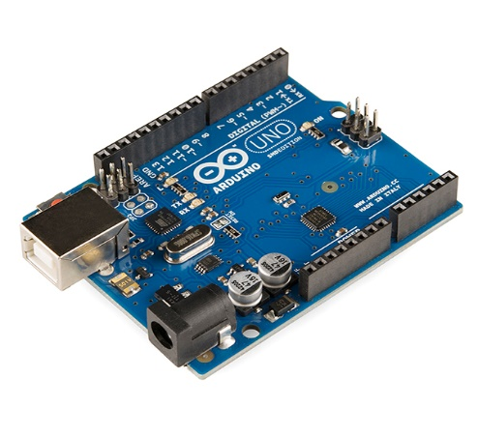


HOME ELECTRICITY USAGE MONITOR
POWER TRANSFORMER ARDUINO
WIFI MODULE WEBSITE

Slide 6
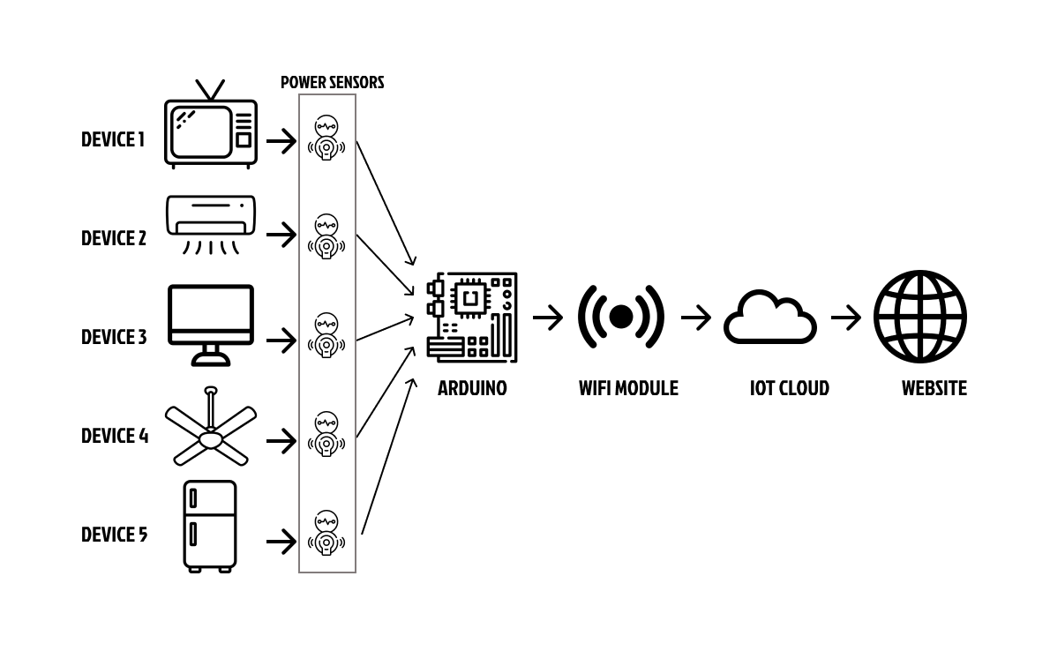
PROCESS EXPLANATION

Slide 7
POWER
HOW CALCULATED ?
INPUT
3 FAN (75 W)
5 LED LIGHTS (10 W)
1 TV (120 W)
TOTAL POWER
=> (3 fans * 75 watts/fan) + (5 LED lights * 10 watts/light) + (1 TV * 120 watts) = 395 W
ENERGY CONSUMPTION
Energy (Wh) = Total Power (Watts) × Time (Hours)
ENERGY = 395 * 12 = 4740 W or 4.74 KWh

Slide 8
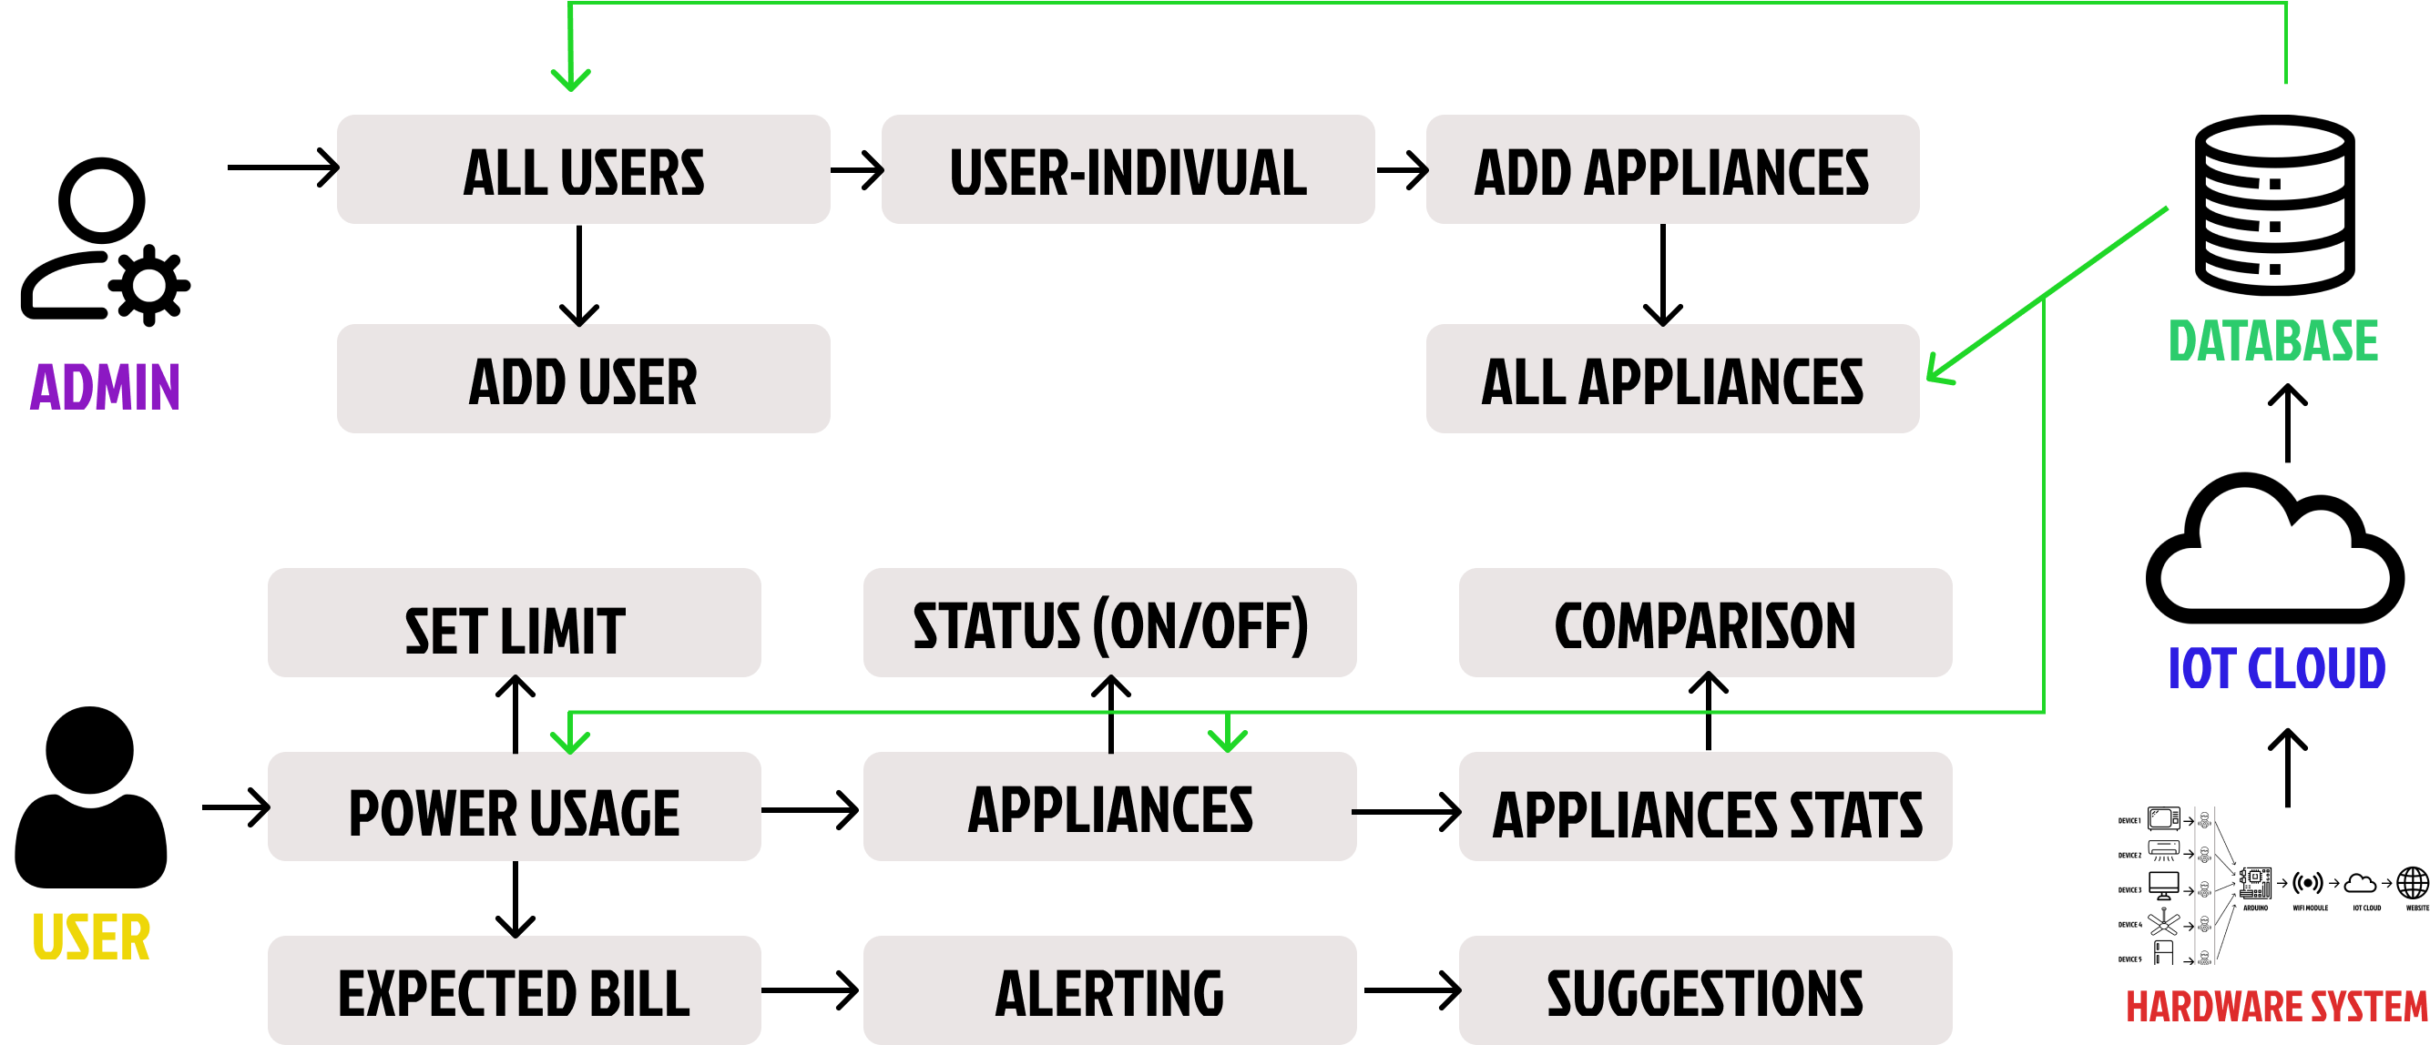
USAGE TRACKER APPLICATION
USE CASE DIAGRAM

